Slide 1
SPRING & HIBERNATE

Slide 2
CONFIGURATION
MUST HAVE JDK
CHANGE TO JAVA PERSPECTIVE
CREATE JAVA PROJECT
DOWNLOAD SPRING JARS
ADD ALL JAR TO BUILD PATH
INVERSION OF CONTROL
MY APP
BASE BALL COACH

Slide 3
APP SHOULD BE CONFIGURABLE
EASILY TO CHANGE FOR ANOTHER SPORTS
LIKE HOCKEY,CRICKATE,TENNIS ETC.
MyApp.JAVA
BaseBallCoach.JAVA
Coach.java INTERFACE AFTER REFACTORING
TRACK.COACH.JAVA
Public class BaseBallCoach{
public String getDailyWorkout(){
return “spend 30min on batting practice”;
}
}

Slide 4
public class MyApp{
Public static void main(String[] args){
BaseBallCoach theCoach = new BaseBallCoach();
System.out.println(theCoach.getDailWorkOut);
}
}
Here we are Creating object of BaseBall Coach
We should create in such that it should work for every coach.
Public interface Coach{
public getDailWorkOut();
}

Slide 5
public class BaseBallCoach implements Coach{
@Override
public String getDailWorkout(){
return “spend 30 min on batting ”;
}
}
public class MyApp{
public static void main(String[] args){
Coach theCoach = new BaseBallCoach();
System.out.println(theCoach.getDailyWorkout());
}
}
o/p- > spend 30 min on batting.

Slide 6
public class TrackCoach implements Coach{
@Override
public String getDailWorkout(){
return “run a hard 5k ”;
}
}
public class MyApp{
public static void main(String[] args){
Coach theCoach = new TrackCoach();
System.out.println(theCoach.getDailyWorkout());
}
}
o/p -> Run a hard 5k

Slide 7
Primary Function
Create and manage object(inversion control)
Inject object’s dependencies(Dependency injection)
Spring
Configuration of Spring Container
XML configuration File(legacy but most legacy app).
Java annotation(modern)
Java source Code(modern)
Object
factory
Spring Dev. Process
Configure Your Beans
Create a spring Container
Retrieve Beans from Spring Container

Slide 8
applicationContext.xml
<bean >
<bean id=“myCoach” class =“fully qualified name of class”>
</bean>
</bean>
This class should implements the interface Coach like BaseBallCoach.
Like alias name
applicationContext.xml
Create a Spring Container
ClasspathXmlApplicationContext context = new ClasspathXmlApplicationContext(“xml file Name”);
Retrieve bean from spring container
Coach theCoach = context.getBean(“myCoach” , Coach.class);
interface
Alias name

Slide 9
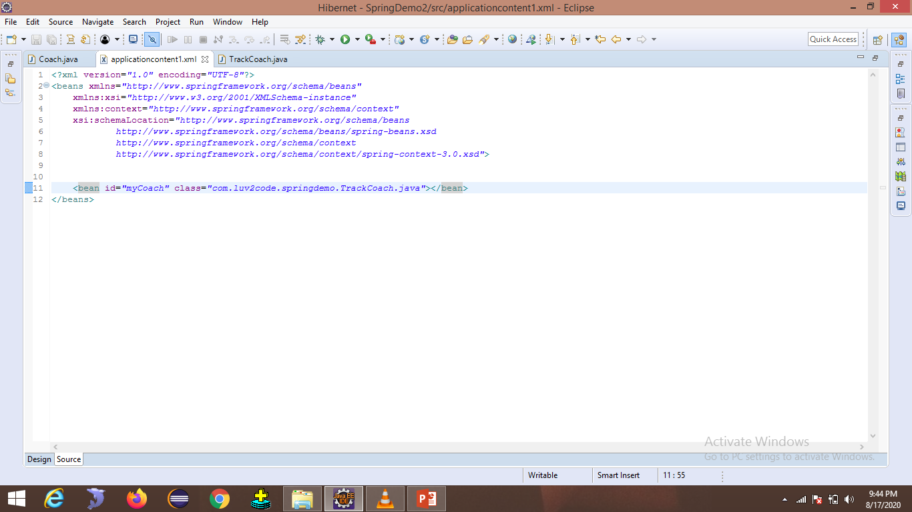

Slide 10
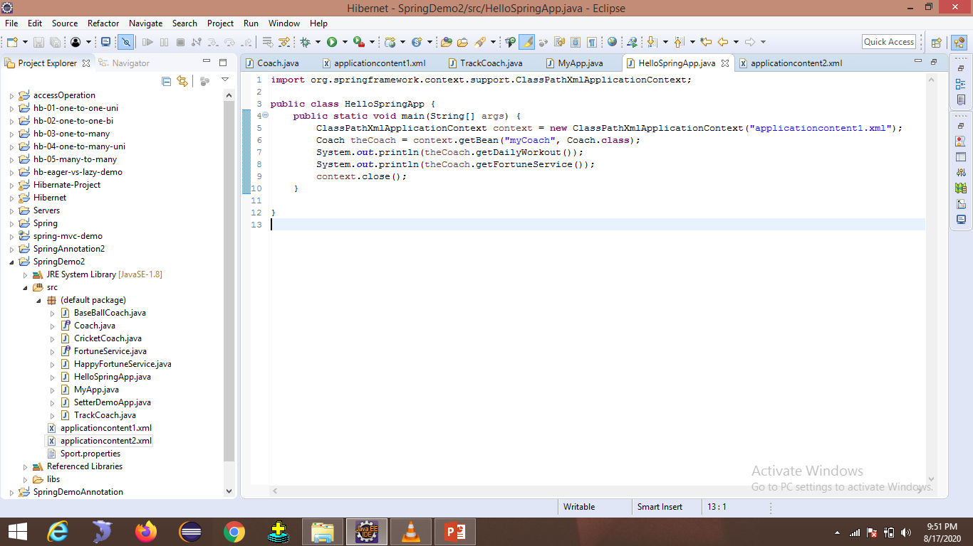

Slide 11
Dependency Injection
1
Give car
customer
Car factory
2
3
Assemble car
There are many type of injection with Spring
We’ll cover the two most common
Constructor injection
Setter injection

Slide 12
Constructor Injection :
Define the dependency interface class.
Create a constructor in your class for injection .
Configure the dependency injection in single file.
Public interface FortuneService{
public String getFortune();
}
Public HappyFortuneService implements FortuneService{
public String getFortune(){
return “Today is your lucky day.!”;
}
}

Slide 13
Public class BaseBallCoach implements Coach{
private FortuneService fortuneService;
public BaseBallcoach(FortuneService thefortuneService){
fortuneService = theFortuneService;
}
}
<bean id=“myFortuneService” class=“HappyFortuneService”>
</bean>
<bean id=“myCoah” class =“BaseBallCoach”>
<constructor-arg ref =“myFortuneService”/>
</bean>

Slide 14
